Slide 1

Programming in Scratch
Lesson 4: Selection

Slide 2
Objectives
In this lesson, you will learn how to:
define selection
perform calculations using variables
alter the pathway of a program using selection
use if-else statements to check a single condition
use nested if-else statements to check multiple conditions.

Slide 3

What do you already know?
Activity 4.1: Single condition selection
Now complete Interactive quiz 4.1.

Slide 4
Programming constructs
Previously, we have looked at sequencing and how this works in programming. Sequencing is one of three key programming constructs:
Sequence
Selection
Iteration
These three concepts are crucial to allow us to solve problems, both in programming and day to day.
Today, we will focus on selection.

Slide 5
Selection
Selection is used to check a condition and then do one thing if the condition is True and another thing if the condition is False.
In programming, this is done using if statements and if-else statements. You may have come across the IF function in spreadsheets, if-else statements work in exactly same way.

Slide 6
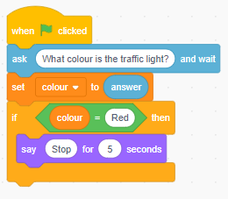
Selection
CONDITION CHECK: this is what is being checked.
DO IF TRUE: This is what the program will do if the condition is True.
If statements will only do something if the condition is True, but what about if it is False?

Slide 7
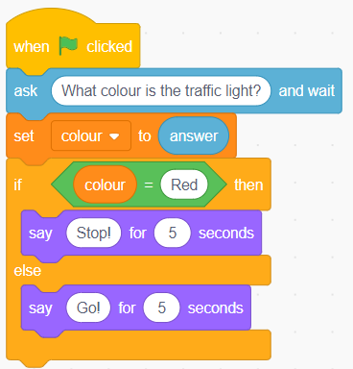
Selection
This is an example of an if-else statement:
CONDITION CHECK: this is what is being checked.
DO IF TRUE: This is what the program will do if the condition is True.
DO IF FALSE: This is what the program will do if the condition is False.
If-else statements will perform one action if the condition is True and another if it is False. They will not perform both actions.
Now watch Video 4.1

Slide 8
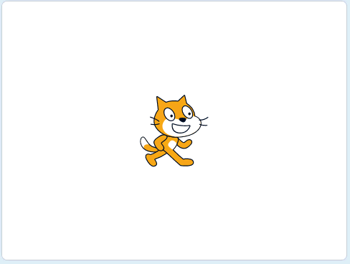
Activity 4.2: Social media sign up
Example of finished solution

Slide 9
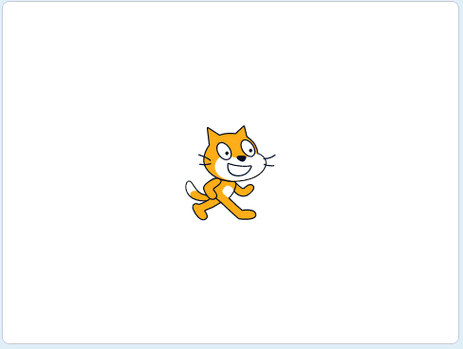
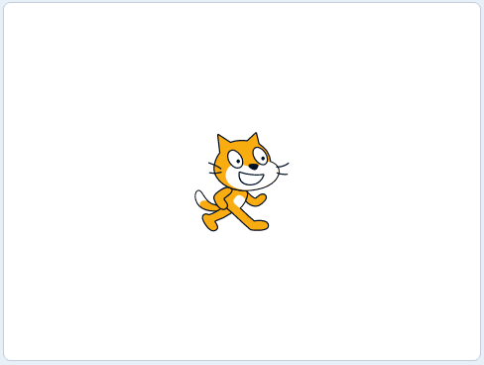

Activity 4.3: Savings
Example of finished solution
Example of extension 1
Example of extension 2

Slide 10
Multiple condition selection
We have seen how you can use selection to check one condition. But what if you need to check more than one condition?
You can nest if-else statements inside if-else statements, so that multiple conditions can be checked.

Slide 11
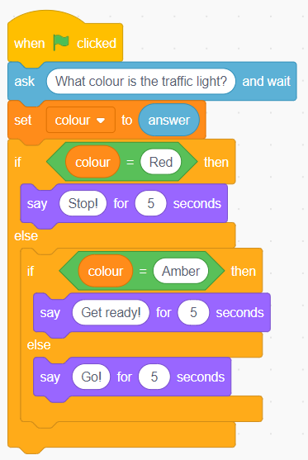
Multiple condition selection
This is an example of how you can check multiple conditions:
FIRST CONDITION CHECK: this is what is being checked first.
DO IF TRUE: This is what the program will do if the first condition is True.
SECOND CONDITION CHECK: This is what the program will do if the first condition is False. It will check a second condition.
DO IF TRUE: This is what the program will do if the first condition is False and the second condition is True.
DO IF FALSE: This is what the program will do if the first condition is False and the second condition is False.

Slide 12
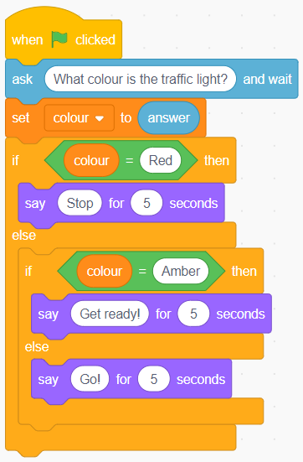
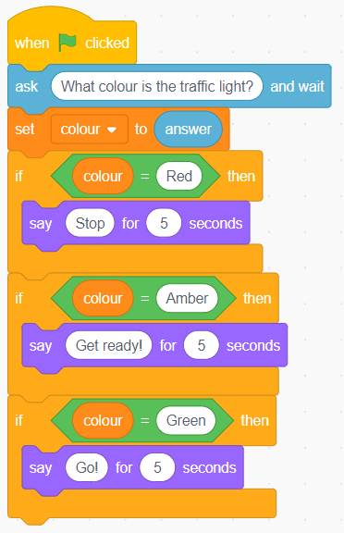
Multiple condition selection
If the first condition is True, the second condition check will not take place.
If you want more than one condition to be checked, you need separate if statements for each check.
Compare these programs:
Watch Video 4.2
This program contains a nested if-else statement. If the first condition is True, the second condition will not be checked
This program contains three separate if statements. All three conditions will be checked

Slide 13
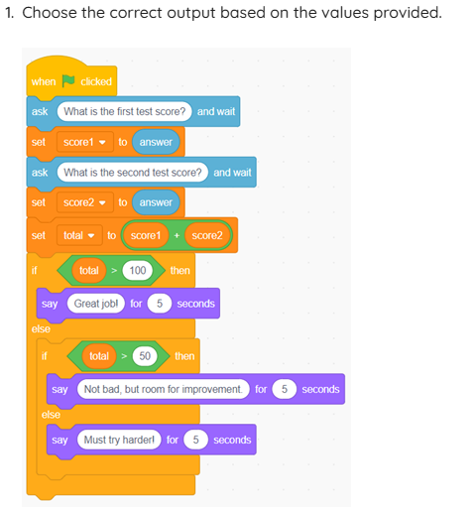
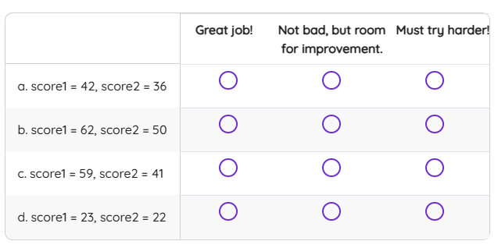
Activity 4.4: Multiple condition selection
Now do Interactive quiz 4.4

Slide 14
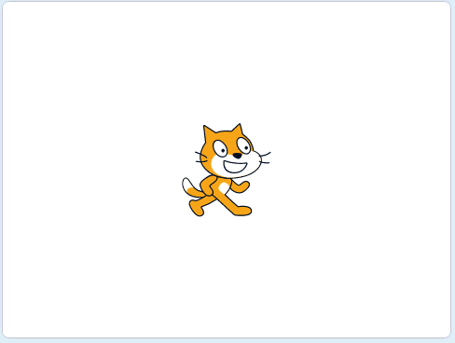
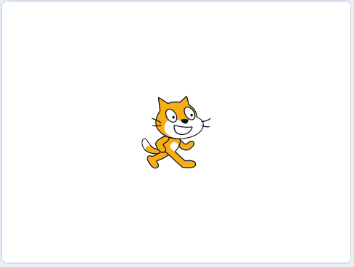

Activity 4.5: Computer game level up
Example of finished solution
Example of extension 1
Example of extension 2

Slide 15
Quiz 4

